Slide 1
Group 5: Investing in Realstate in North Carolina
Alex, Rima, Mohamad, Carlos

Slide 2
Investing in North Carolina Real-state Market
If you are planning to invest in a property in NC, which counties have the greatest potential for growth based on historic price evolution?
Sources:
Monthly average price for housing by county? Zillow (2010-01 to 2019-05)
Monthly average days in market for houses by county? Zillow (2010-01 to 2019-05)
Monthly average number of houses for sale by county? Zillow (2010-01 to 2019-04)

Slide 3
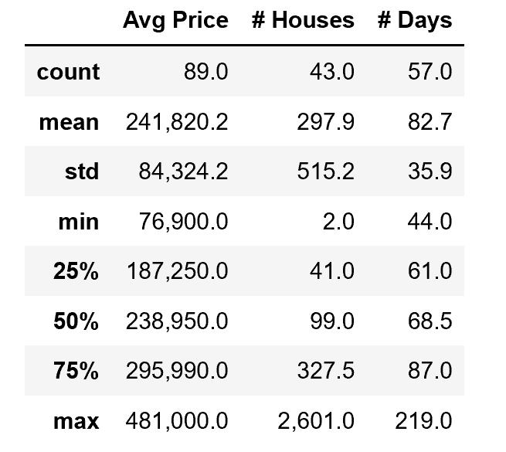
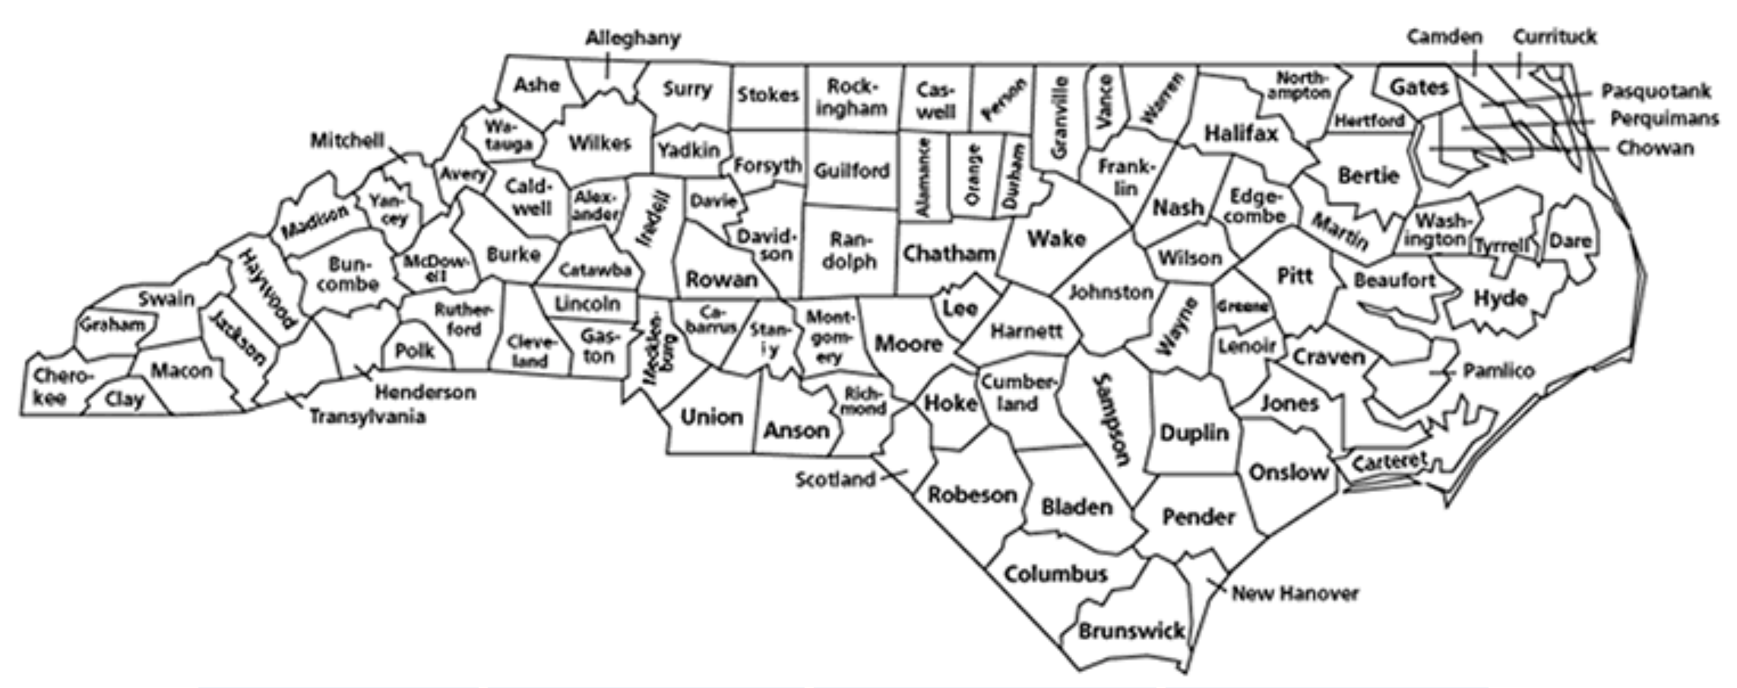
North Carolina in May 2019: Housing Data
In May 2019, the average price per house in NC was $241,820, an average of 298 houses were on sale across the counties, and houses stayed in the market around 83 days.
County with Minimum Avg Price per house was $76,900 in Edgecombe County
County with Maximum Avg Price per house was $481,000 in Chatham County
Wake County
350,000 2,044 53
Charlotte

Slide 4
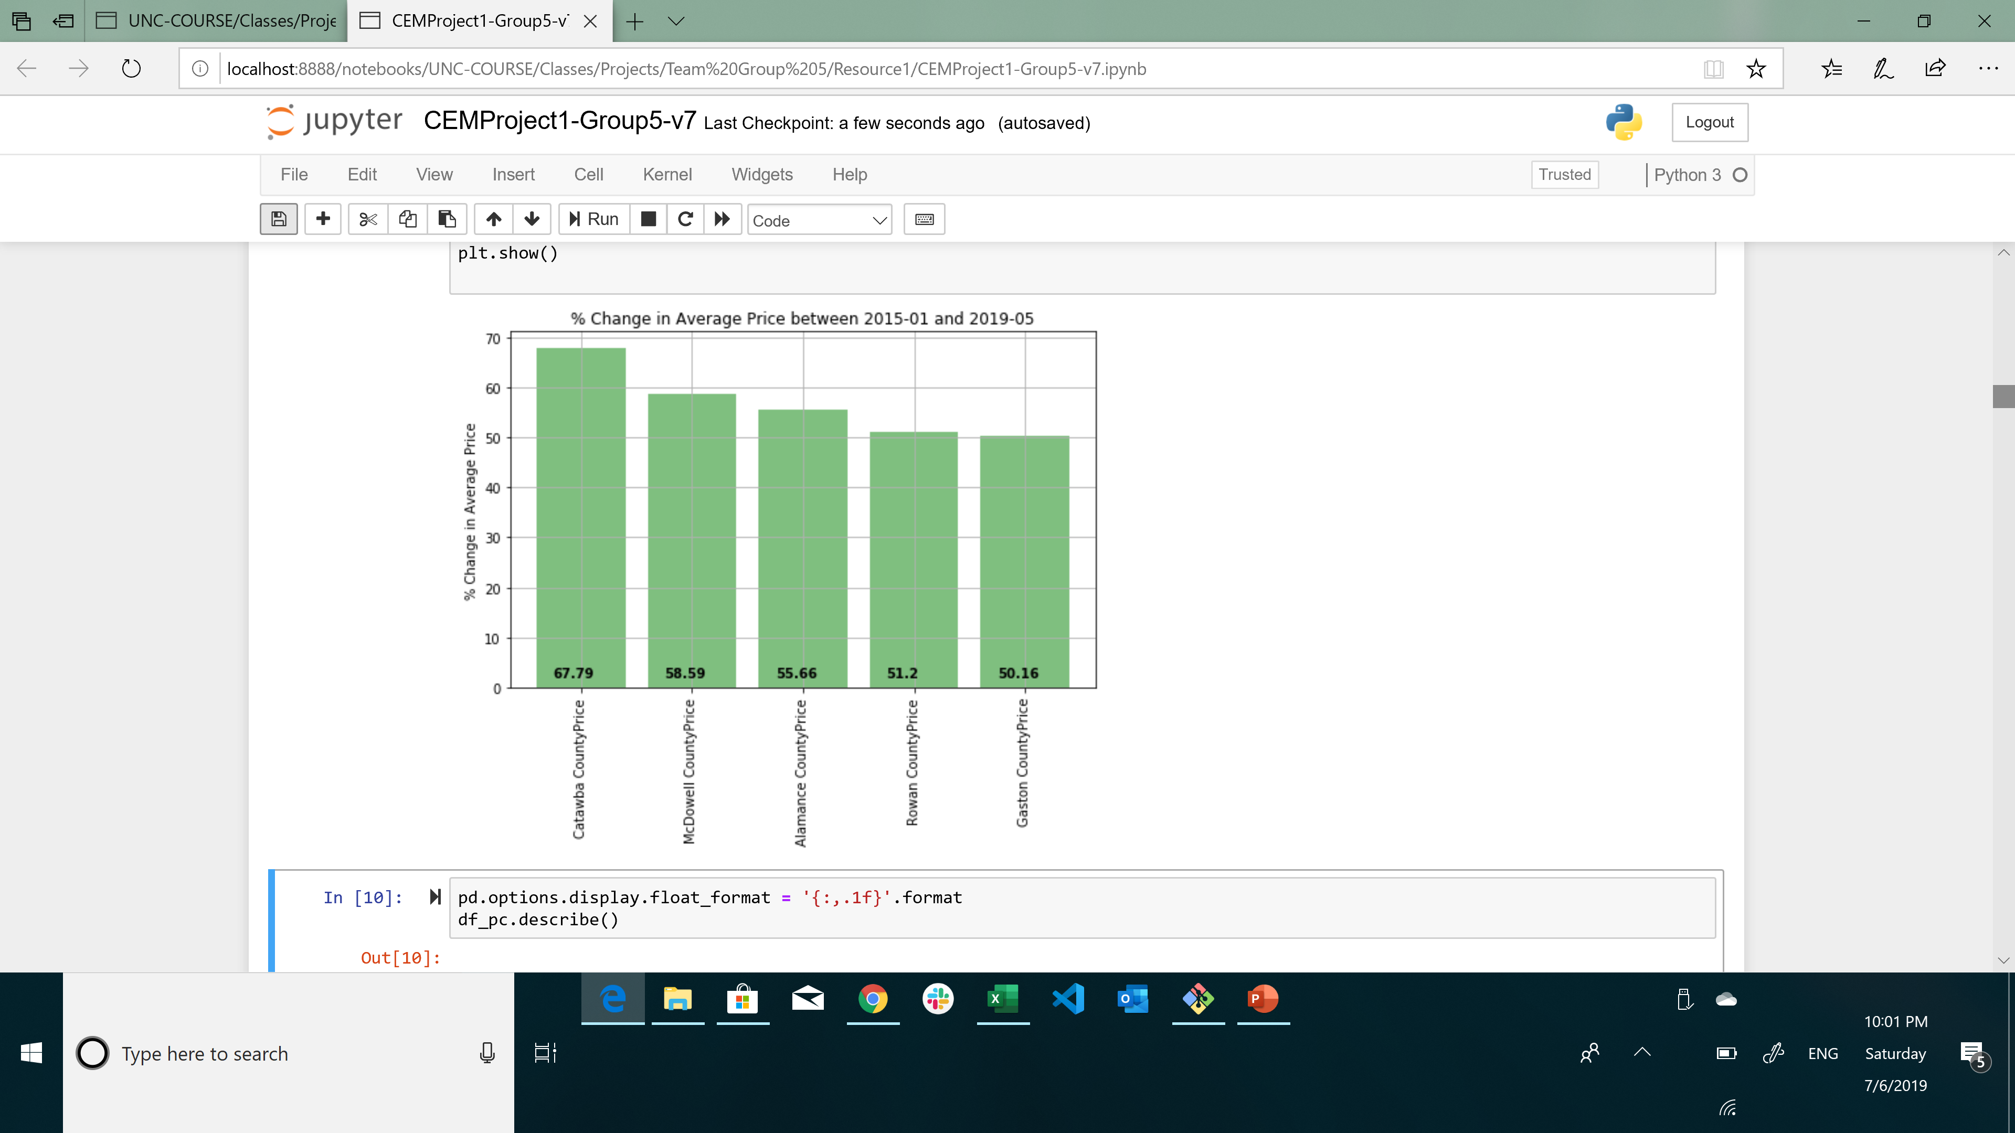
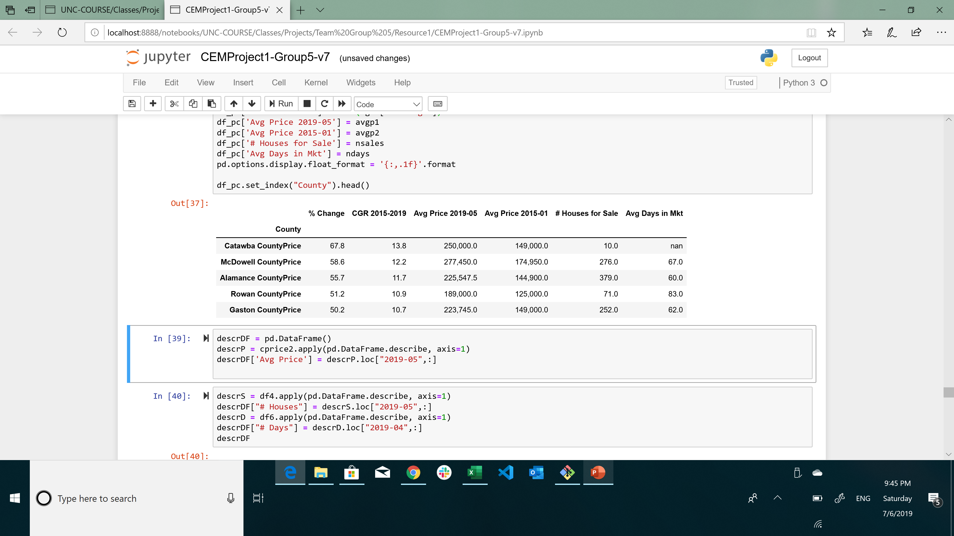
If you are planning to invest in a property in NC, which counties have the greatest potential for growth based on historic trends?
Between 2015-01 to 2019-05, prices grew on average 26.8%.
Minimum Avg Price growth was -1.4% in Columbus County
Maximum Avg Price growth was +67.8% in Catawba County
The top five counties by average price growth are as follows:
1
2
3
4
5
3
2
1
4
5
Notes:
Graham County is a county located in the U.S. state of North Carolina. As of the 2010 census, the population was 8,861,^{[1]} making it the third-least populous county in North Carolina
Catawba County is a county located in the U.S. state of North Carolina. As of the 2010 census, the population was 154,810.^{[1]} Its county seat is Newton,^{[2]} and its largest city is Hickory. The county is part of the Hickory–Lenoir–Morganton, NC Metropolitan Statistical Area.
Catawba County is part of the "North Carolina Data Center Corridor" in western North Carolina.^{[3]} Maiden is home to the Apple iCloud data center and the largest privately owned solar farm in the United States (operated by Apple). As of 2017, the Catawba County Economic Development Corporation controls a 55-acre business park in Conover designed for data centers and office use.^{[4]} CommScope and Corning, manufacturers of fiber optic cabling, became the region’s largest employers in the late 1990s.
In January 2008 and January 2010, Greenville was named one of the nation's "100 Best Communities for Young People" by the America's Promise Alliance.^{[5][6]} In June 2012, Greenville was ranked in the top ten of the nation's "Best Small Places For Business And Careers" by Forbes magazine.^{[7]} In 2010 Greenville was ranked twenty-fourth in mid-city business growth and development by Forbes Magazine.
Today, Alamance County is often described as a "bedroom" community, with many residents living in the county and working elsewhere due to low tax rates, although the county is still a major player in the textile and manufacturing industries. The current county-wide tax rate for Alamance County residents is 58.0 cents per $100 valuation. This does not include tax rates imposed by municipalities or fire districts.

Slide 5
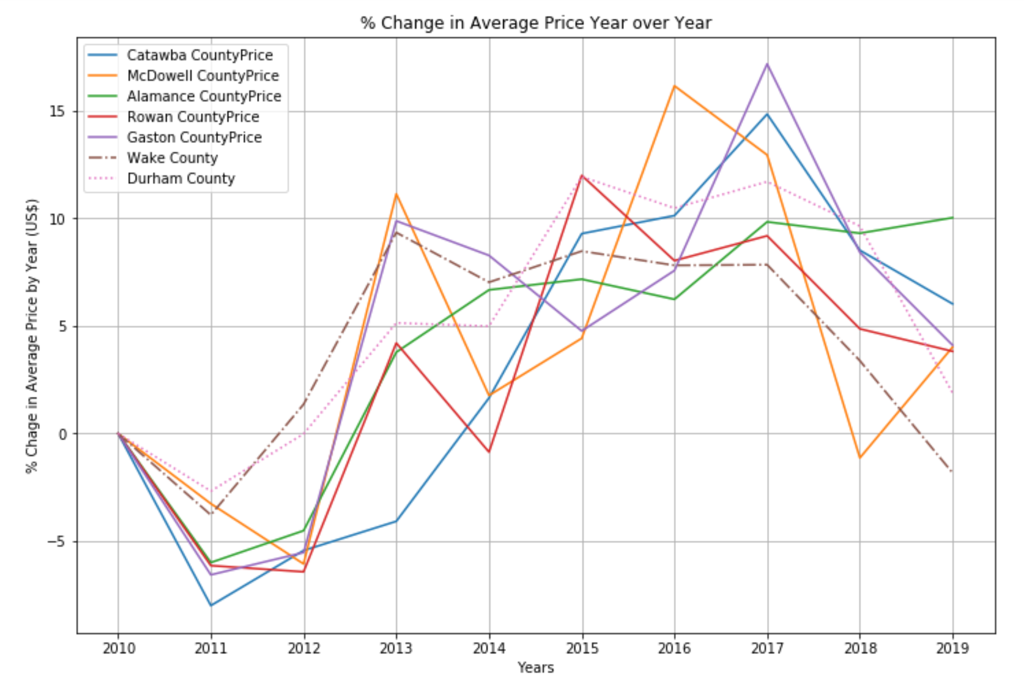
Average Price Increase Year over Year:
Most Top Five counties had a peak growth between 2015 and 2017,
However, counties slowed down in 2018 and 2019. Though, Alamance County is keeping a steady growth in 2019.
Note: Wake and Durham county are included as reference
Peak Growth
Slow Down

Slide 6
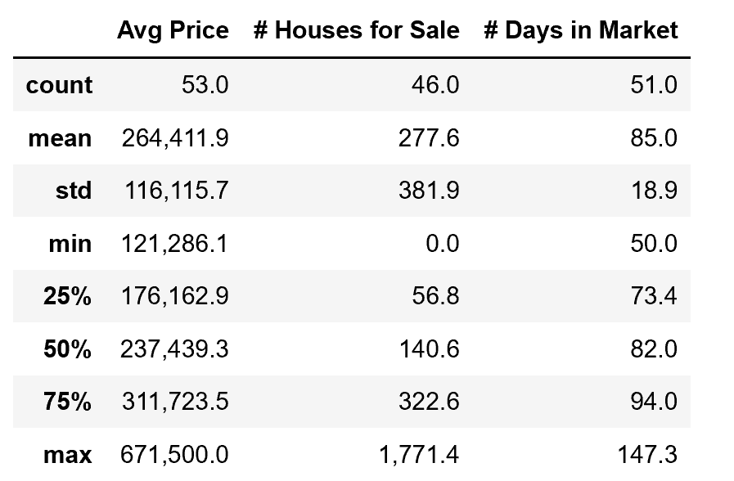
North Carolina vs. US:
North Carolina is a good place to invest as prices are still slightly below the US average, and price growth is slightly higher vs. the nation
US: 2019-05 Summary
NC: 2019-05 Summary
*
*
Wake & Durham
County | Avg. Price | # Houses | #Days | Growth
Wake | 350,000 | 2,044 | 53 | 27.8%
Durham | 295,000 | 470 | 44 | 47.5%
* For 2019-04
Average Price per house in NC vs. US: NC average price homes slightly lower vs. US
Min
Mean
Max
US
121,286.1
264,411.9
671,500.0
North Carolina
Min
76,900
Mean
241,820
Wake County
350,000
Max
481,000
Average Price growth in NC vs. US: NC average growth is slightly higher vs. US
Min
Mean
Max
US
-14.4%
21%
61.8%
North Carolina
Min
-1.4%
Mean
26.8%
Max
67.8%
Wake County
27.8%

Slide 7
Backup Slides

Slide 8
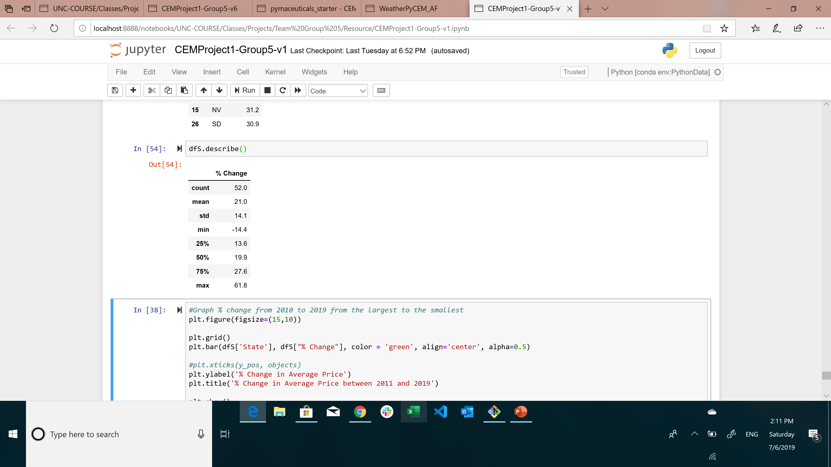
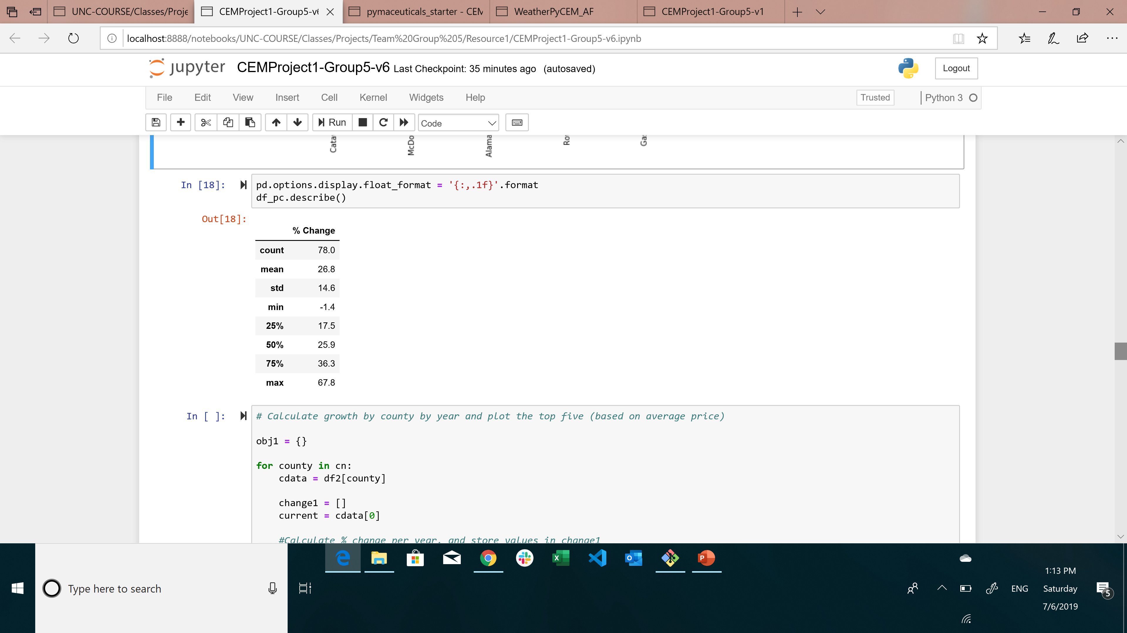
US: Growth 2015-01 to 2019-05
NC: Growth 2015-01 to 2019-05

